Slide 1
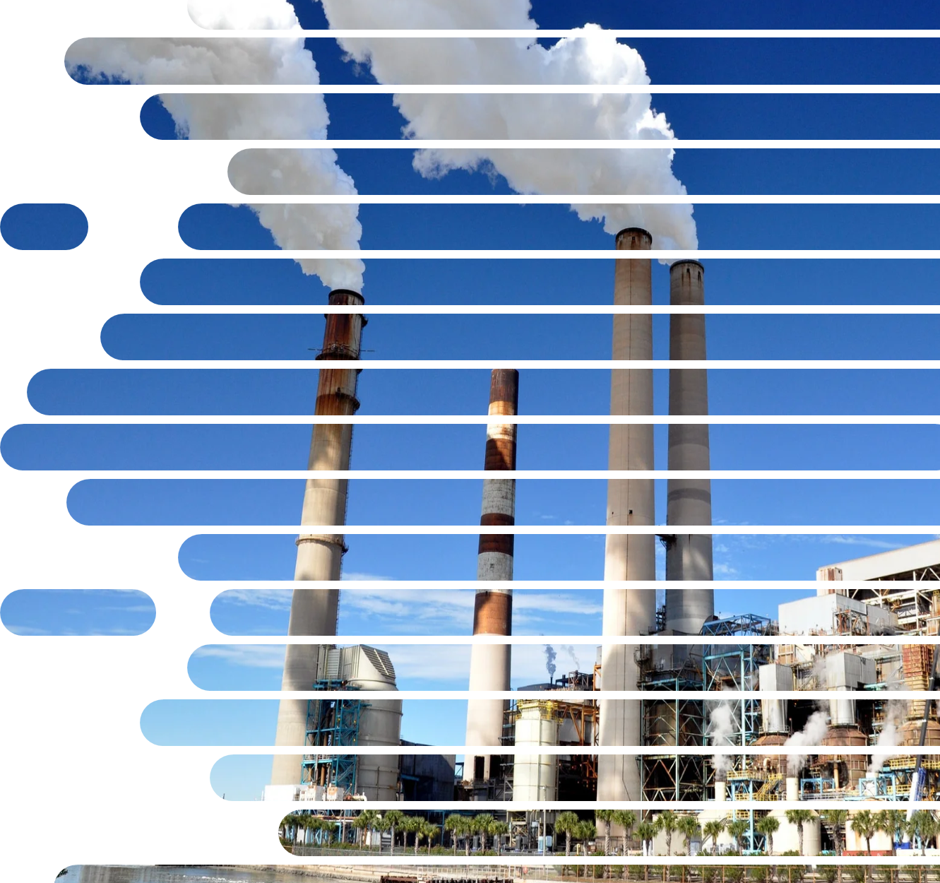
Capstone 2 Project
Global CO2 Emissions Prediction
Zizhong Liu
Springboard – May 2021

Slide 2
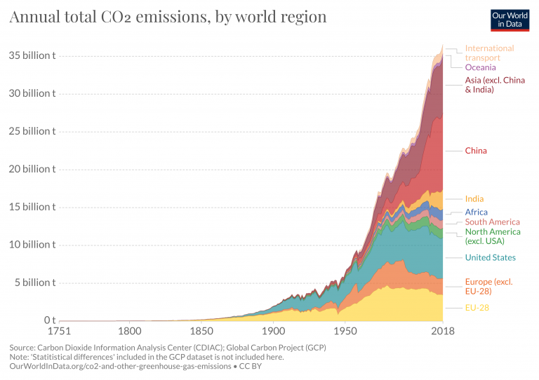
Introduction
Problem Statement
The growth of CO2 emissions is a major contributing factor to the speed of climate change.
Since 1970, CO2 emissions have increased by about 90%,.
In order to prioritize which initiative has the highest impact on reducing CO2 emissions, governments and industries must be equipped with high-performing, predictive tools for future emissions.
Key Stakeholders
Politics and policies: ministries, departments, agencies, and directions of national governments;
Research and education: universities, institutes, research centers, laboratories;
Supply and demand: industrial companies related to energy, food, air, equipment manufacturing, etc.;
Organizations, societies, and influencers related to energy, environment, health, etc.

Slide 3
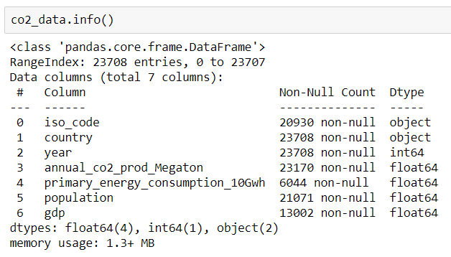
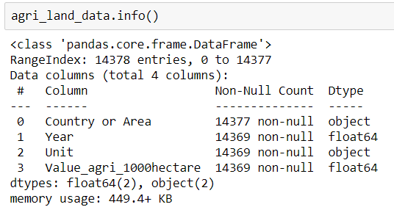
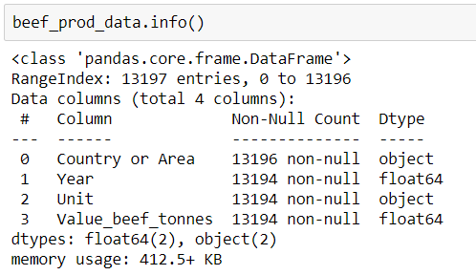
Data Preprocessing
Data Overview
The CO2 and Greenhouse Gas Emissions dataset is a collection of key metrics maintained by Our World in Data. It includes data on CO2 emissions (annual, per capita, cumulative and consumption-based), other greenhouse gases, energy mix, and other relevant metrics of different countries from the year 1750 - 2019.
The data set of agriculture and food production are sourced from UNDATA containing the information on agricultural land use and beef production of different countries from the year 1750 - 2019.
🔗
🔗

Slide 4
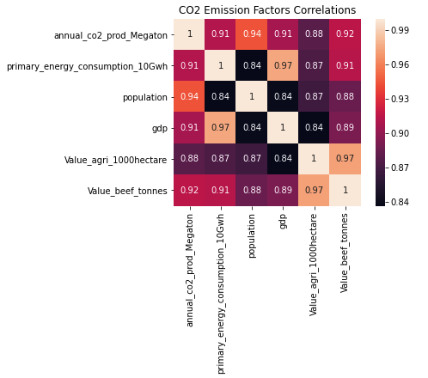
Data Preprocessing
Data Analysis
Annual CO2 production has the strong correlation with:
population (0.94)
beef production (0.92)
primary energy consumption and GDP (0.91)

Slide 5
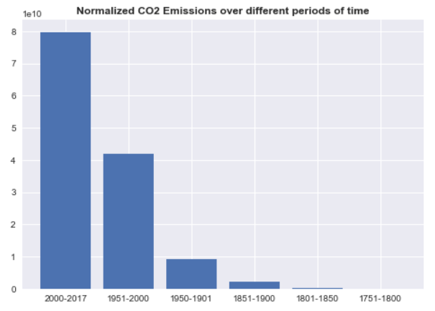
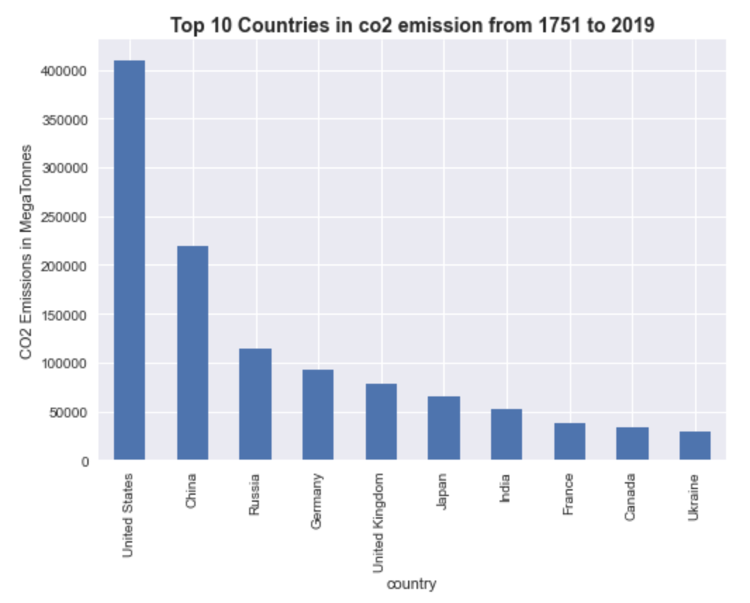
Data Preprocessing
Data Analysis

Slide 6
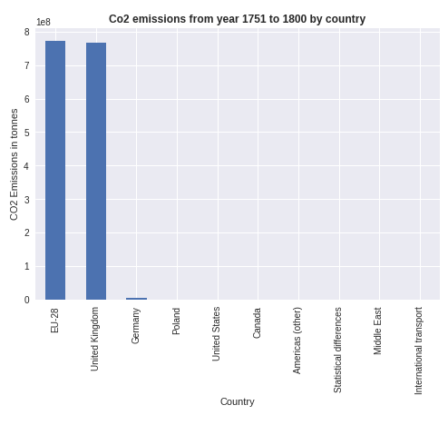
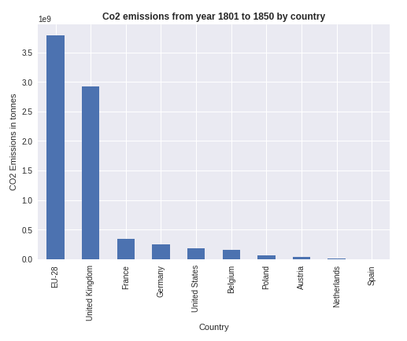
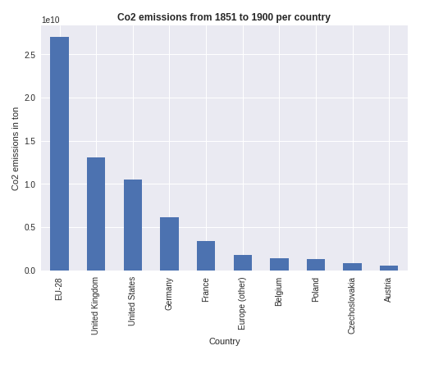
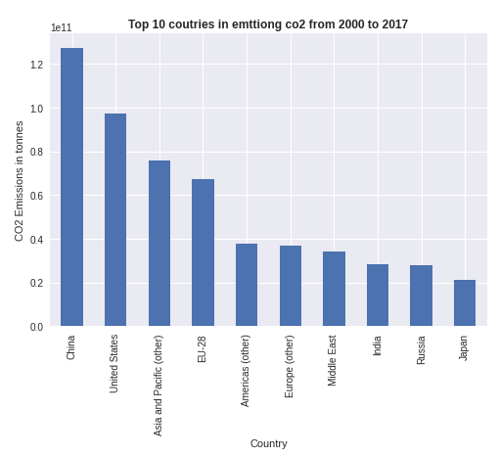
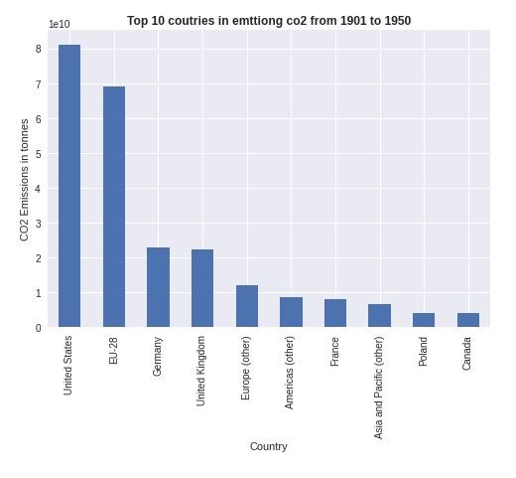
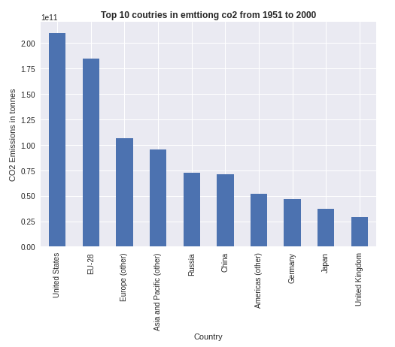
Data Preprocessing
Data Analysis

Slide 7
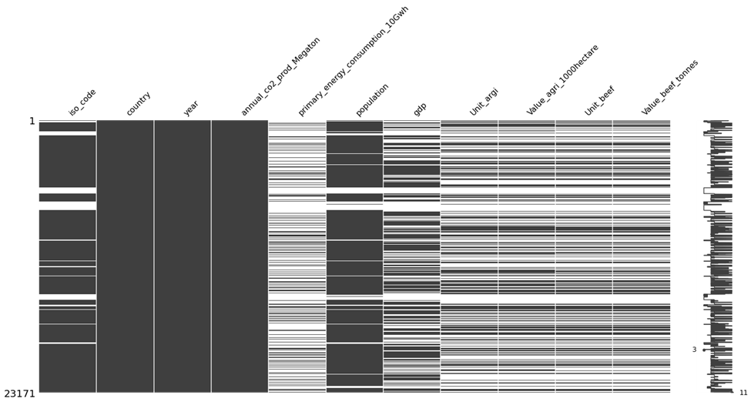
Data Preprocessing
Featuring Engineering
Selected Features
Processing
iso_code: categorical feature.
country: categorical feature.
Year: date/time feature
annual_co2_prod_Megaton: numerical feature.
primary_energy_consumption_10Gwh: numerical feature. Population: numerical feature.
Gdp: numerical feature.
Value_agri_1000hectare: numerical feature.
Value_beef_tonnes: numerical feature.
NaN data: “fillna” to be replaced by the value of 0
Thresholds: primary energy > 70k and 110k
Region names: Africa, Europe, USA, China, India, and Russian.

Slide 8

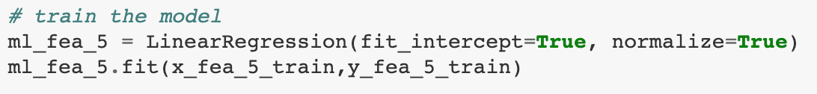
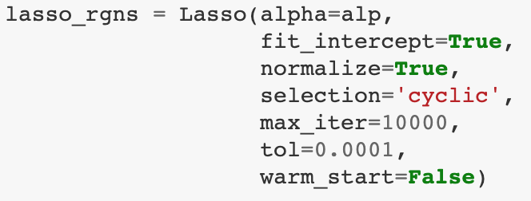
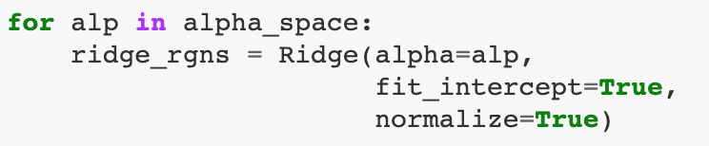
Modeling
Model Selection
Linear Regression
Lasso Regression
Ridge Regression
(https://scikit-learn.org/stable/tutorial/machine_learning_map/index.html)

Slide 9
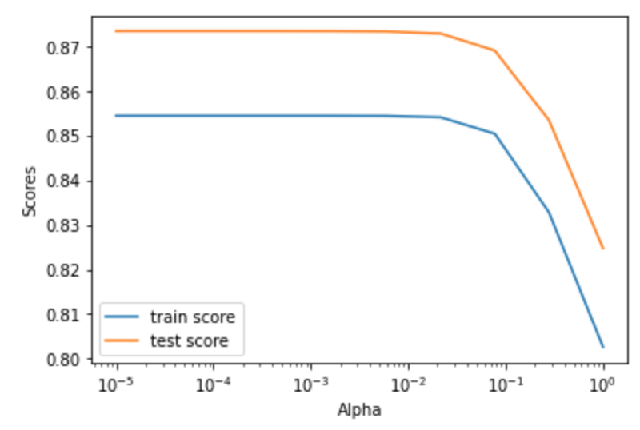
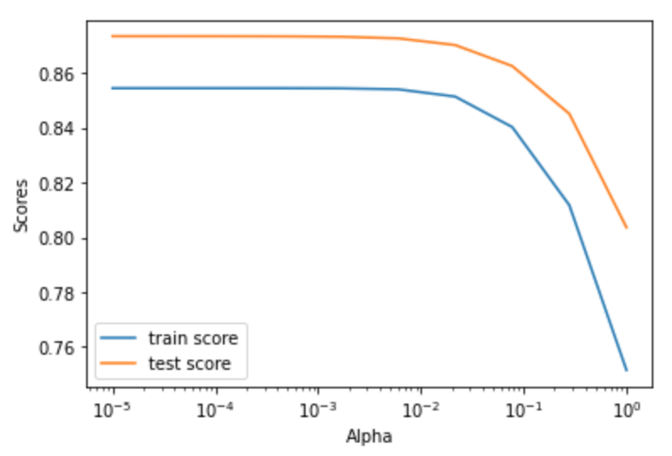
Results and Discussions
Hypertable
Rank | r2_train | rmse_train | r2_test | rmse_test | alpha | incpt | description
1 | 0.8544 | 554.3107 | 0.8734 | 581.6483 | 0.00E+00 | -532.32 | Linear
2 | 0.8544 | 554.3107 | 0.8734 | 581.6486 | 1.00E-05 | -532.30 | Lasso
3 | 0.8544 | 554.3107 | 0.8734 | 581.6493 | 3.60E-05 | -532.26 | Lasso
4 | 0.8544 | 554.3107 | 0.8734 | 581.6508 | 1.00E-05 | -532.31 | Ridge
5 | 0.8544 | 554.3107 | 0.8734 | 581.6520 | 1.29E-04 | -532.11 | Lasso
Lasso Regression
Ridge Regression

Slide 10
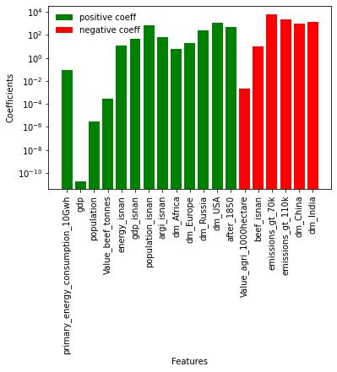
Results and Discussions
Coefficients
Observations
CO2 emission is positively related to primary energy consumption, GDP, population, and beef production, but reversely related to agriculture land use.
United States, Europe, Russian, and Africa contributions are positively related to CO2 emission, but China and India are negatively related to CO2 emission.
The possible explanation can be:
Low contribution of CO2 emission per person of China and India due to huge population in these two countries causes low per capita CO2 emission.
China and India have larger agriculture land use and less beef production.

Slide 11
Conclusions
This work investigated CO2 emissions by considering five main factors, including primary energy consumption, GDP, population, agriculture land use, and beef production.
Three machine learning regression models (linear, Lasso, and Ridge) are applied to the training and test data set in order to predict CO2 emission.
The results show that multivariate linear regression is the best performance model for this data set.
The coefficients of each feature show that CO2 emission is positively related to primary energy consumption, GDP, population, and beef production but agriculture land use has a negative effect on CO2 emission.
The dummy variable coefficients show that United States, Europe, Russian, and Africa contributions are positively related to CO2 emission, but China and India are negatively related to CO2 emission.
Future works:
Add geological features based on the location of countries.
Add temporal features based on time period.
Standardize the features. It is important to standardize the features by removing the mean and scaling to unit variance.
Consider extra ML/AI models, including NLP and ANN.

